Slide 1
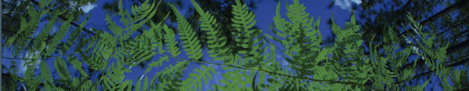

Occurrence Record Cleaning
University of Florida

Slide 2
What data are we using?

Slide 3
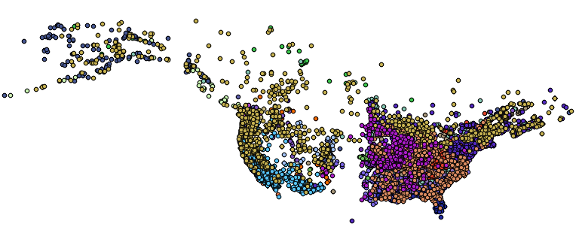
What data are we using?
1. Georeferenced occurrence records

Slide 4
Georeferenced
01_Download_Occurrence_Data.R
02_Occurrence_Data_Cleaning.R
Request points

Slide 5
Identify points where locality strings are present, AND lat/long are absent.
Georeferenced
01_Download_Occurrence_Data.R
02_Occurrence_Data_Cleaning.R
Request points

Slide 6
Identify points where locality strings are present, AND lat/long are absent.
Georeferenced
01_Download_Occurrence_Data.R
02_Occurrence_Data_Cleaning.R
Request points
Identify flagged points for locality data withheld by collection managers
Common with protected species

Slide 7
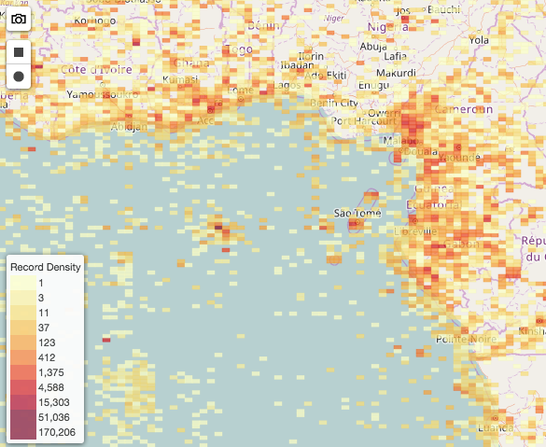
Occurrence data cleaning
Select columns
Check taxon names
Location cleaning
Precision
Remove impossible points
Most common coordinate: 0.00, 0.00
Cultivated zones, botanical gardens, etc
Remove duplicates
Remove coordinates outside desired range

Slide 8
Occurrence data cleaning
Select columns
Check taxon names
Location cleaning
Precision
Remove impossible points
Most common coordinate: 0.00, 0.00
Cultivated zones, botanical gardens, etc
Remove duplicates
Remove coordinates outside desired range

Slide 9
Manual
Excel or google sheet option
See steps in ENMWorkshop_2020.docx

Slide 10
Occurrence data cleaning
02_ Occurrence_Data_Cleaning.R
Exploring the dataset– dplyr
Select columns
Check taxon names
Synonyms
iPlant TNRS Tool (RCurl, rjson)
Location cleaning – CoordinateCleaner
Precision
Remove impossible points
Most common coordinate: 0.00, 0.00
Cultivated zones, botanical gardens, etc
Remove duplicates
5. Visualize the points - ggplot2, raster, sp

Slide 11
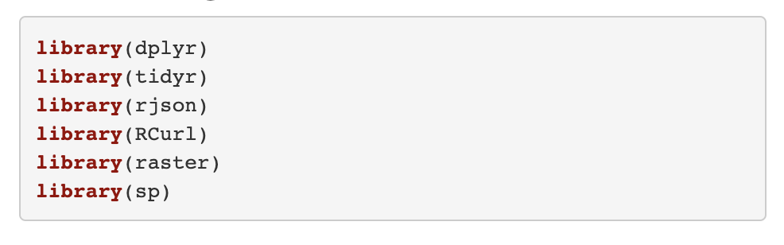
Load Packages
dplyr and tidyr are part of tidyverse
rjson and RCurl are used to query an application programming interface (API), or an online database.
Geospatial packages include raster and sp

Slide 12
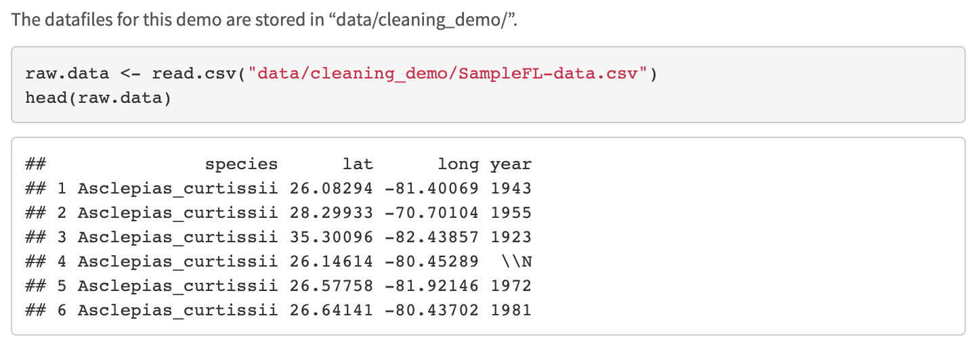
Load Data Files
read.csv is a base function of R, it reads csv files
head function prints the first 6 rows of a dataframe

Slide 13
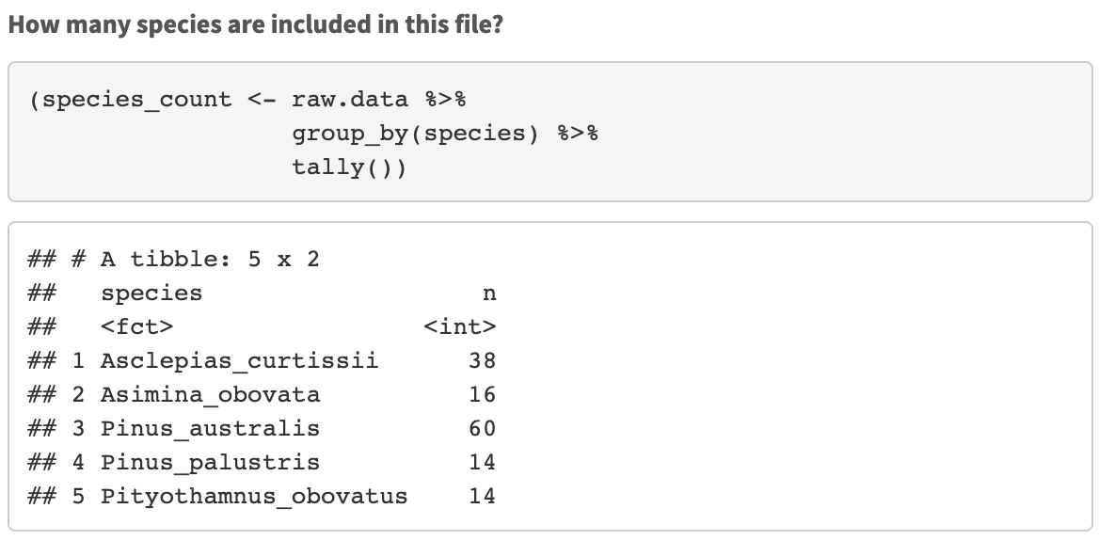
Look at the datafile
Using dpylr we:
group by species: group_by(species)
then we count how many records we have for each species: tally()

Slide 14
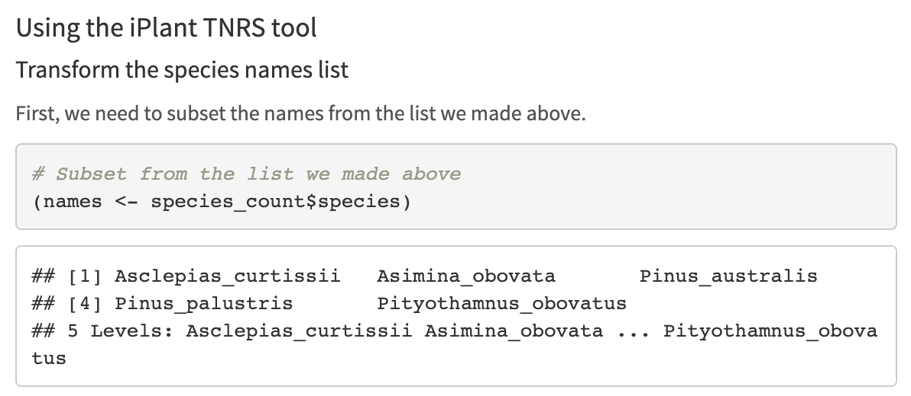
Taxonomic Cleaning
We are going to be query http://tnrs.iplantcollaborative.org/

Slide 15
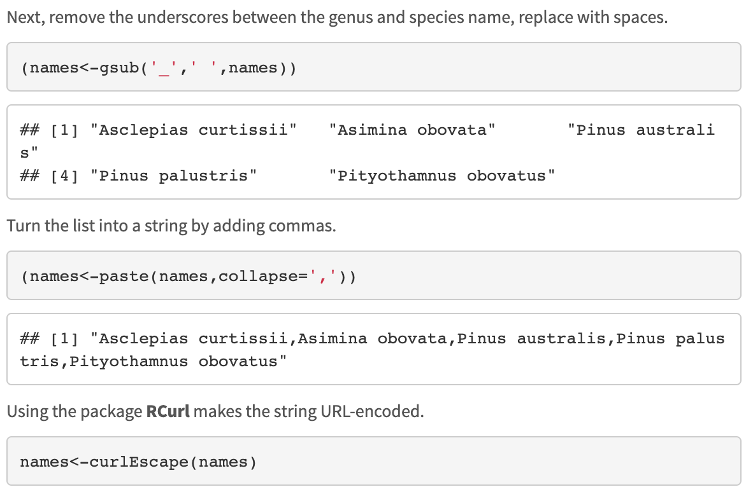
Taxonomic Cleaning
gsub replaces all matches of a string
paste concatenate vectors after converting them to characters
curlEscape makes the string URL-encoded

Slide 16
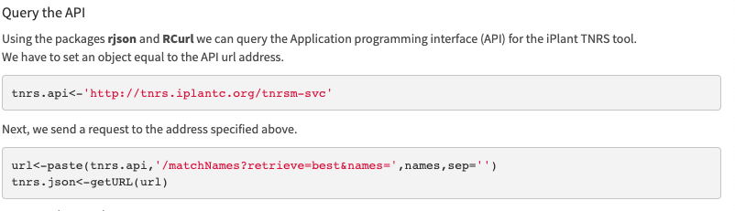
Taxonomic Cleaning
Create an object with the API address
Create the API request and getURL

Slide 17
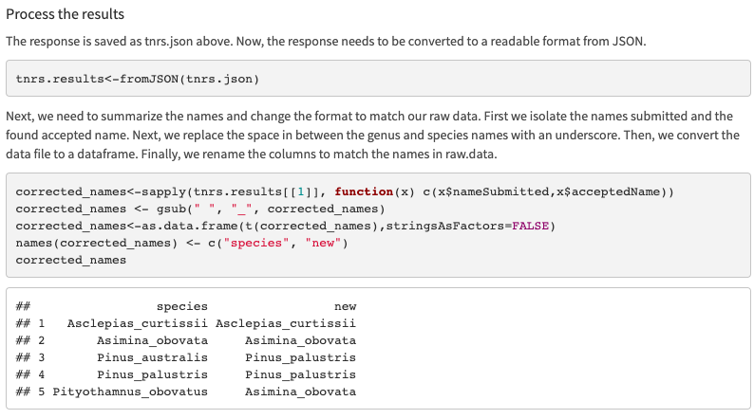
Taxonomic Cleaning

Slide 18
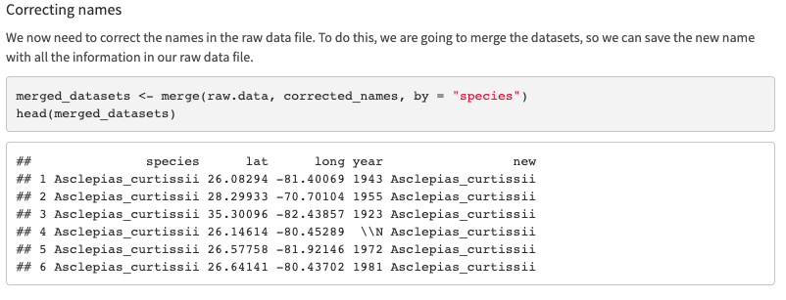
Taxonomic Cleaning

Slide 19
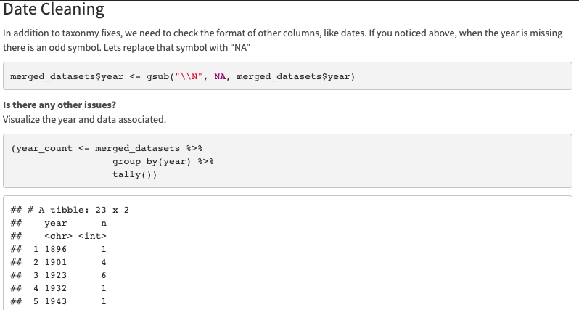
Date Cleaning

Slide 20
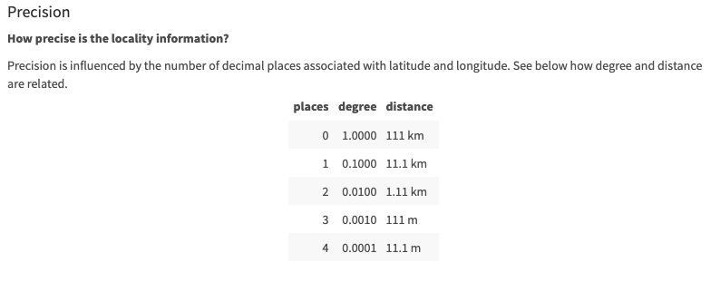
Location Cleaning

Slide 21
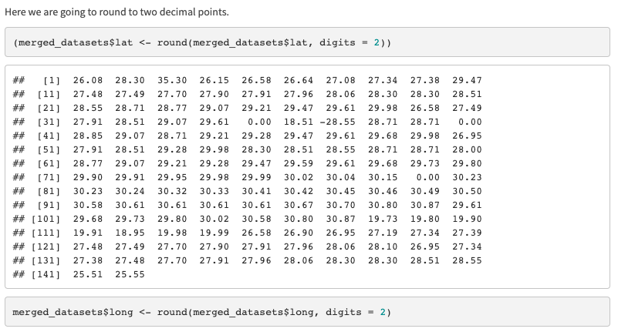
Location Cleaning

Slide 22
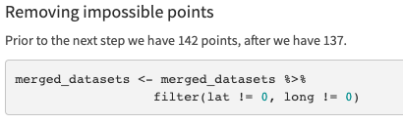
Location Cleaning

Slide 23
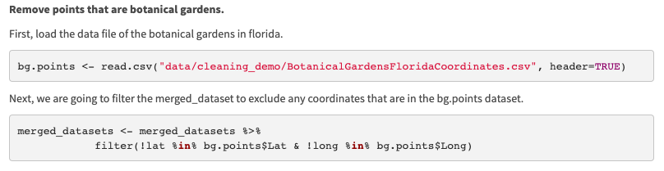
Location Cleaning
Other options: CoordinateCleaner

Slide 24
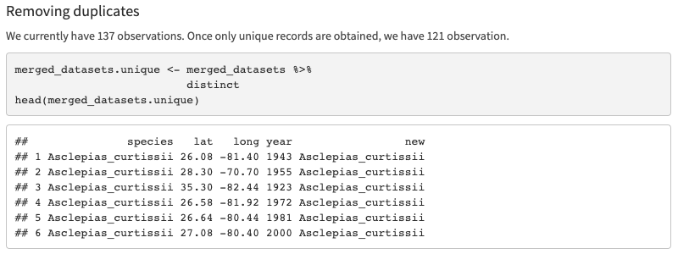
Location Cleaning

Slide 25
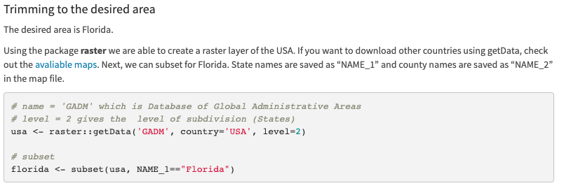
Location Cleaning

Slide 26
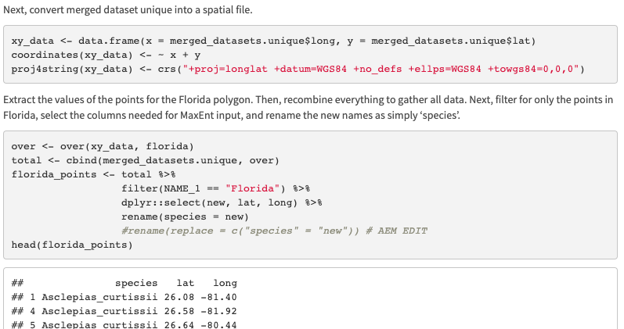
Location Cleaning

Slide 27
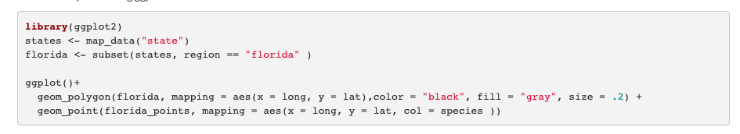
Visualize

Slide 28
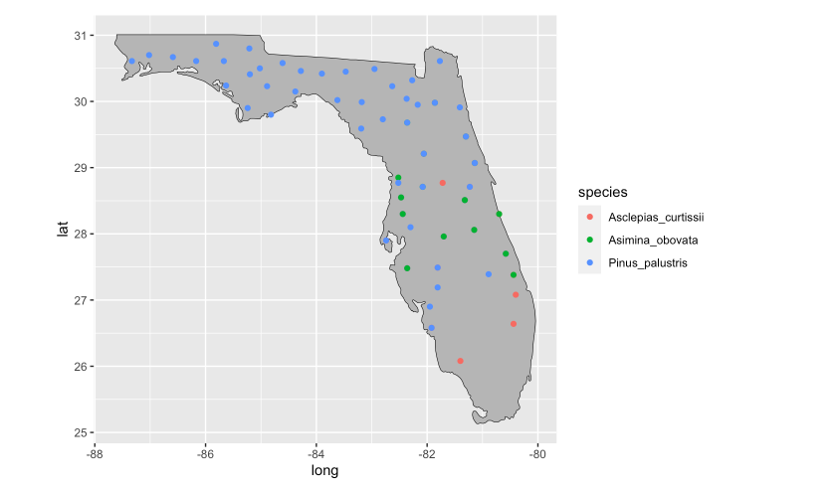
Visualize

Slide 29

Save cleaned data

